Slide 1
Climate of Hungary
Attila Varga

Slide 2
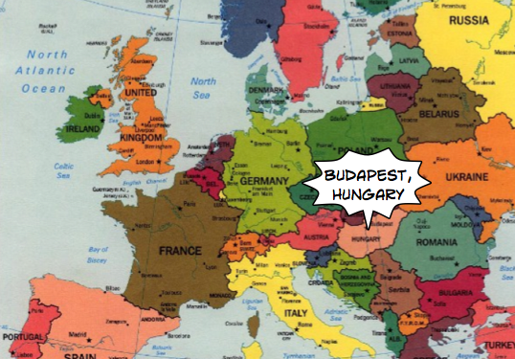

Slide 3
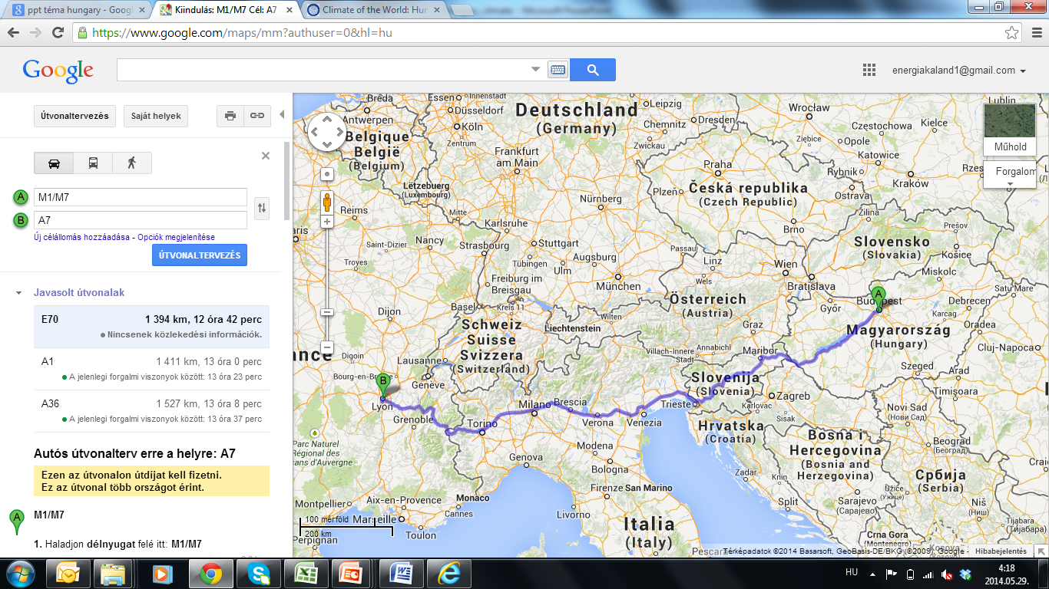
Notes:
1400 km

Slide 4

Summer
Warm and dry, lot of sunshine
More than 30°C
Notes:
Four seasons

Slide 5
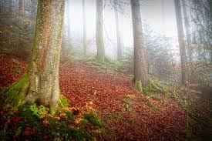
Autumn
Lot of rain and fog
10-20 °C

Slide 6
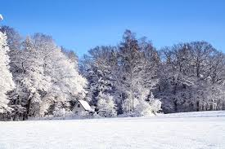
Winter
Cold and windy, often with snow
Under 0°C

Slide 7
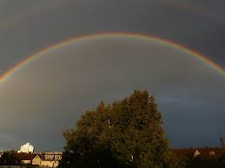
Spring
Rainy but often sunny
10-20 °C

Slide 8

Climate change
Less snow in winter
More storm
Hot in summer – sometimes over 40 °C

