Slide 1
No: 223 Goals and benefits of co-teaching sciences and philosophy
Lyon, France
16/06/2014-20/06/2014

Slide 4
St. Elizabeth´s cathedral Košice

Slide 5
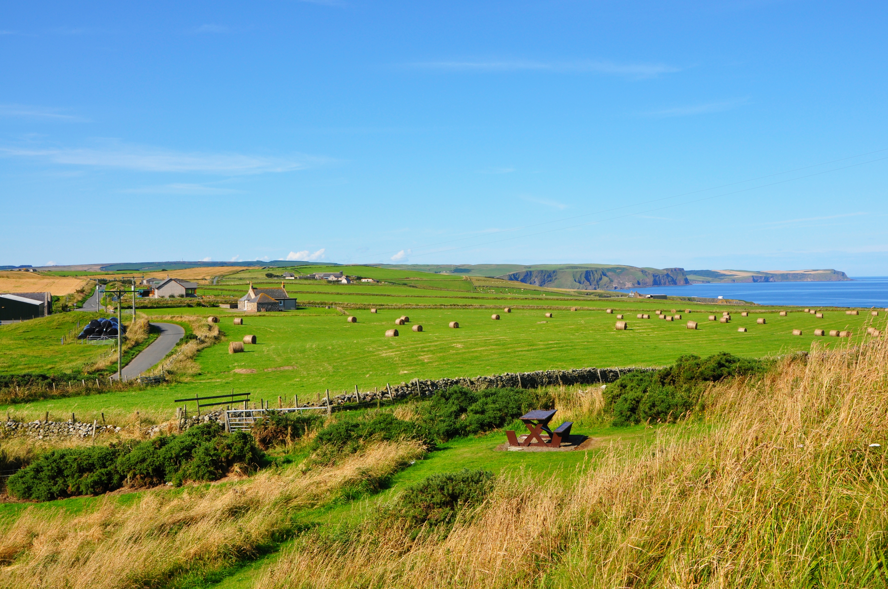
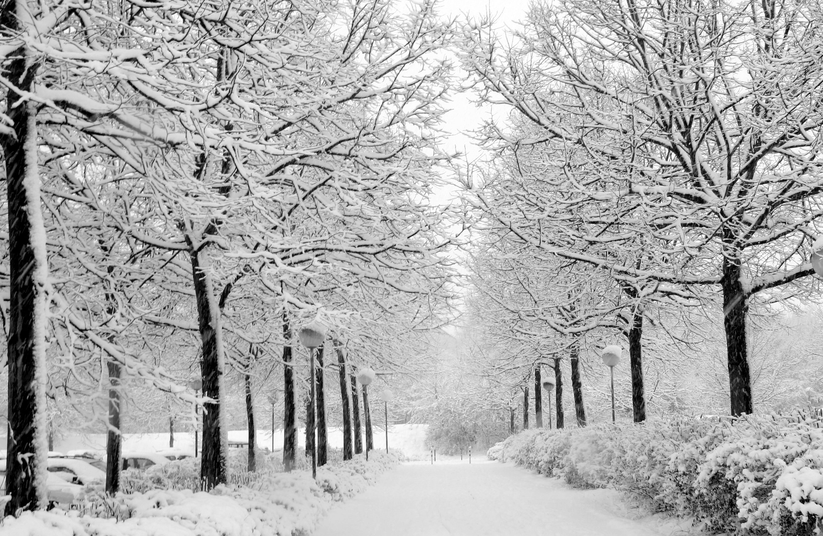
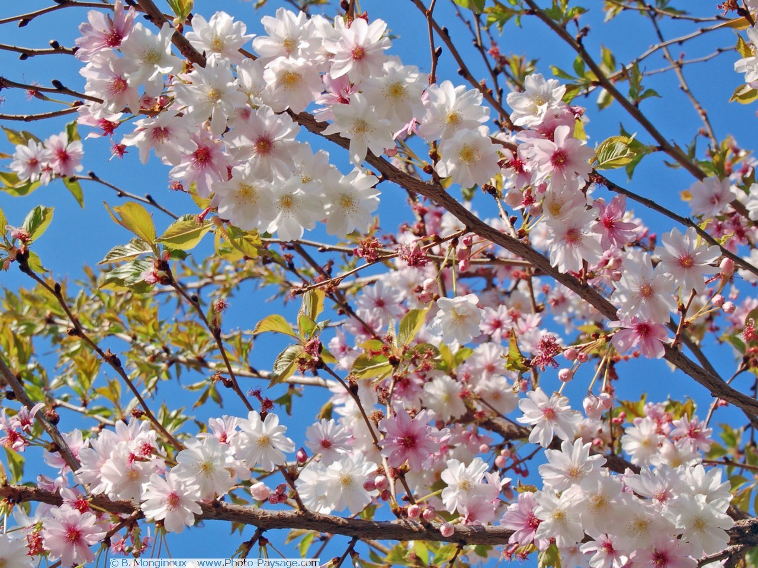
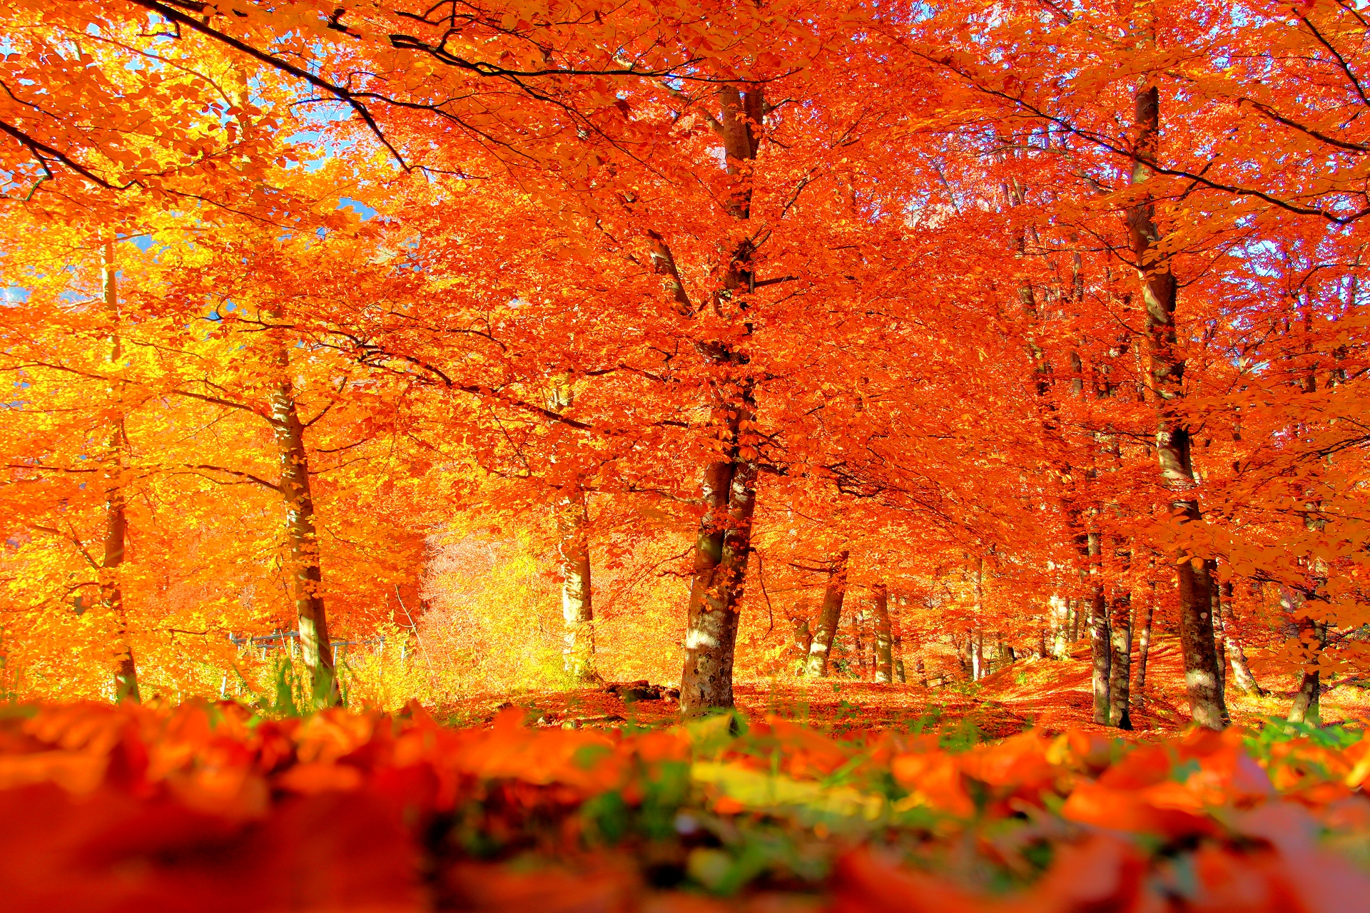
WEATHER
The Slovak Republic has a continental climate with 4 seasons:
SUMMER
WINTER
SPRING
The coldest month is January
The hottest month is July
AUTUMN

Slide 6
WEATHER
Summers are hot.
The average daily temperature in
summer is 21 °C,
but can be as warm as over 30 °C
The period from May to July is often considered the best season.
During the summer, sunrise is before 5:00 and sunset is about 21:00.
SUMMER

Slide 7
WEATHER
Winters are cold, cloudy and humid. The average winter daily
temeratureis - 2 °C, but can
plummet to - 15 °C.
During the winters the sunrises approximately
at 7:30 and sets about 16:00.
WINTER

