Slide 1

Lobkowitz-Realschule Neustadt a. d. Waldnaab
Bavaria,
Germany
Irene Sebald
13.06. 2014

Slide 2
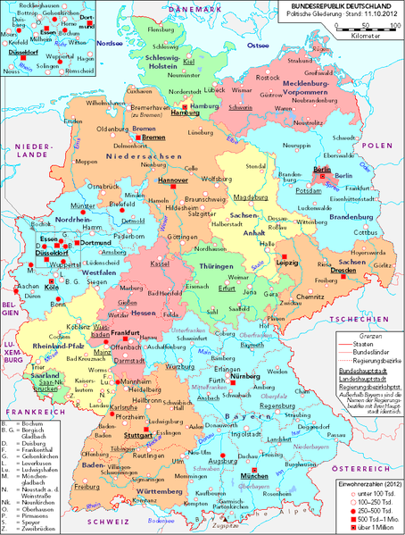
Inhabitants:
nearly 5.938
Area:
about 9,94 km²
http://commons.wikimedia.org/wiki/File%3ADeutschland_politisch_2010.png
http://upload.wikimedia.org/wikipedia/commons/4/4a/Deutschland_politisch_2010.png
C. Busch, Hamburg

Slide 3
Most important economic branches in the region
Production of china and crystal glass
Electronic industry
Machine factories
Breweries
Farming
Small businesses
Tourism

Slide 4
Most important agricultural branches in the region
Cattle breeding
Grain crops
Dairy farming
Forestry
Fish farming

Slide 5
Education in Bavaria The Bavarian educational system
In Germany each state is responsible for its own educational policy
Further information:
Basic Structure of the Education System in the Federal Republic of Germany
→ http://www.kmk.org/dokumentation/das-bildungswesen-in-der-bundesrepublik-deutschland.html
http://www.kmk.org/dokumentation/das-bildungswesen-in-der-bundesrepublik-deutschland/dossier-deutsch.html

Slide 6
Education in Bavaria
More than 5,500 schools
Main categories:
schools of general education vocational schools
and schools of adult education
Flexible school system
General rule:
Receiving a school certificate
→ enter the next higher academic level

Slide 7
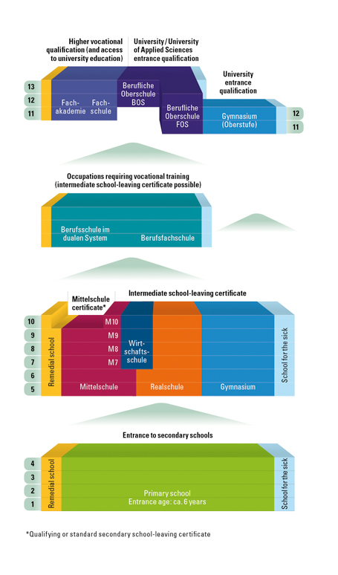

The Bavarian educational system
Gymnasium (higher level)
Vocational secondary school
Vocational training
Intermediate secondary school certificate
Secondary schools:
- Mittelschule = general, vocationally oriented
- Realschule = professionally oriented
- Gymnasium = university-preparatory
Primary school: first general school
Preschool level: advising & support phase
https://www.km.bayern.de/education-in-bavaria.html

Slide 8
Realschule/ Secondary modern school
for young people who are interested in
theoretical issues/knowledge and
practical work
provides a general education and
prepares for profession
Further information:
www.realschule.bayern.de

Slide 9
Facts about my school
Secondary modern school
since 1964
https://www.lobkowitz-realschule.de

Slide 10
Facts about my school
701 students in 27 classes → classes 5 - 10
- 62 teachers
10 teachers are being trained at my school
there are four different ways of education with focus on
either mathematical
or economical
or a second foreign language (French)
or cooking, nourishment and household
→ students can choose according to their
abilities and interests (→ starts in class 7)

Slide 11
Subjects
Languages:
German, English, French,
Czech (optional subject)
Artistic Subjects:
Music, Art, Economy,
Sports
Natural Science:
Biology, Physics, Chemistry, Maths,
Information Technology (IT)
Social Science:
Religious Education, Geography, History, Business management,
Social Studies

Slide 12
Optional Subjects
Czech
School Band, Chorus, Percussion-Group,
Vocal-Ensemble, Brass Band, Dancing Group, Theatre
School magazine
Student Company
Volleyball, Table-Tennis, Football
Mediators, Tutors (students helping students)
Fit for real life - activities

Slide 13
Experiences/Realization/ Implementation/Practice
Talent classes: classes 5-6 (two extra lessons)
Natural Science
Art
Dancing
Languages (French, Czech)
Music (Choir and Percussion)

Slide 14
Experiences/Realization/ Implementation/Practice
Entrepreneurship:
Student Company
Partnership with important companies in our town
Work Placement:
It‘s an important part of our school-system:
Each student is doing a practical training in a company, business, factory…
Girls‘ Day:
Girls can try typical male occupations or rather technical professions
→ giving insight into scientific and technical jobs to increase/promote them

Slide 15
Dual Systems in Germany
Dual System of education/studies, is…
… a combination of higher education/university
degrees with practical training in companies.
The difference to the classical way of education/
studies is a higher practical relevance.

Slide 16
Ways to be innovative in the field of education: new teaching methods
Project-Presentation (class 9):
one main topic for all 9th graders, e.g. our school town
all pupils go together in groups of 4 and…
>> choose one special topic for the group, e.g. tourism/
history/jobs/music/sports/population/culture …. in
my school town
->> prepare a 20-minutes-presentation
->> time: 2 months
->> advising and support by different teachers: IT,
German, History, Business Management, Music etc.
->> result: multi-media presentation, theatre play, tourist
or church guide ->> every pupil is an expert!

Slide 17
Methods- Curriculum: - as a preparation for the project-presentation - starts in class 5 - 4 new methods every year - training in all subjects

Slide 20
Media- Curriculum: - as a preparation for the project-presentation - class 5-9 - technical know-how - making presentations with different media: poster, info-flyer, computer, camera etc. - introduction (IT), training (all subjects)

Slide 21
Bavarian speciality: Religious Education → co-teaching science and philosophy example: the Creation (class 8): Who is right? – The Bible or Natural Science?

Slide 22
Bavarian speciality: Religious Education → co-teaching science and philosophy example: the time of your life (class 6): What is time? How to spend your time in a sensible way.

Slide 23
Positive effects of co-teaching: - modern curriculum (outcomes based) - core competences and life-long-learning - individual approach is possible - interdisciplinarity allows flexibility - knowledge is no more isolated - learning by doing (showing the practical application of knowledge) - stimulating creativity - fun learning

Slide 24
Obstacles: - teachers are not trained to teach new competences - teachers don`t want to co-operate with other disciplines - teachers` resistance to changes

Slide 25
Thank you very much for your attention!

